Slide 1

California Green Cultivation
Robert Pinchuck

Slide 2
CONTENTS
PROJECT OVERVIEW
Bio of CGC Managing Partner and CEO
Colorado Product Services
Colorado Product Service pictures
Bio of CPS Managing Partner and CEO
Purple Haze Properties
Jimi Hendrix
Cannabis Facts and Market Overview
Business Model
Investment Income Projection
Sales Projection and Investment
Report Highlights
Jimi Hendrix & Cannabis
What’s in it for CGC?
Using Jimi Hendrix Intellectual Property
Purple Haze Properties PR Value
Purple Haze Products
3
5
6
8
10
11
12
13
14
15
16
18
23
24
25
26
27

Slide 3
PROJECT OVERVIEW
California Green Cultivation, LLC (CGC), is owned and operated by Robert Pinchuck who also serves as President/CEO of Colorado Product Services, Rifle, Colorado (CPS). Robert Bult CPS from the grown up He handles all licensing of medical marĳuana products for the Jimi Hendrix brand know as Purple Haze Properties. California Green Cultivation, LLC is also preparing for approval election of California Recreation Sales License. Mr. Robert Pinchuck’s legal counsels and business contacts helped insure his Cannabis shop, Doctor’s Garden was the first to open in the Rocky Mountains. California Green Cultivation, LLC is an exclusive California licensee to sell cannabis based products in the category of edibles, medicine, and certain other products with all the Jimi Hendrix Works. California Green Cultivation, LLC has the rights to use of all the Jimi Hendrix Works to promote and sell cannabis products that include photographic, and/or pictorial images, designs and/or artwork depicting Jimi Hendrix, and including use of the names “Jimi”, e.g. “Jimi’s Cannabis Collection”, and Jimi Hendrix song titles.
We are operating the Purple Haze Properties website www.purplehazeproperties.com for the promotion, advertisement and sale of Products bearing the Jimi Hendrix Works. We will also have access to all pre-existing non-exclusive cannabis product Licensees at the end of their License term. California Green Cultivation, LLC will be the solo exclusive California licensee of all Jimi Hendrix products. Hendrix is one of the most popular figures in the marĳuana industry with over 2 billion followers worldwide that follow his media, legacy and history. Purple haze properties carries over 25 Hendrix branded products such as edibles, genetic, and meds.
Continue >>

Slide 4
PROJECT OVERVIEW
These products will become California Green Cultivation, LLC property.California Green Cultivation, LLC will be sub licensing Jimi Hendrix brand to Producers and manufactures of edibles, and medicines in California. There over 900 edible manufacturers and over 700 medicine producers in California. There are over 50 different categories of edibles products and over 30 categories of medicine products. We will be sub licensing to the top quality producers of each category of the products and will have over 50 sub licensees.
Jimi Hendrix exclusive licensor is operated by Andrew Pitsicalis with over 20 years in the Cannabis Industry, from Cultivation, to Production, Sales, Education, Media and Consulting. Mr. Pitsicalis, owned one of the largest high end functional glass distribution companies in the world. With the works of the greatest glassblowers, he has distributed these fine works to hundreds of smoke shops and collectors. He was an original partner in Cannabis travel events, High Times events and has had his Glass Collections and Genetics featured in Cannabis Magazines throughout the years. He is a member of Cannabis Science, a leader in cannabis scientific research as the brand and licensing director and sitting member of the policy advisory board.
Purple Haze Properties, LLC was founded through a partnership between Andrew Pitsicalis and Leon Hendrix, blood brother to the legendary guitar icon. Purple Haze Properties, LLC is one of the premiere sources for Jimi Hendrix cannabis related products. They participate in all aspects of the cannabis industry including Licensing, Social, Medical, Music and Entertainment areas.

Slide 5
Bio of CGC Managing Partner and CEO
Robert Pinchuck has been President and CEO of Columbia Law List for over 30 years. Columbia Law List has been marketing and consulting law firms since 1905. Columbia Law List owns top ranked attorney products and services, which are listed on columbiafinancial.us. Legal compliance training has been the focus of business operations.
Rob Pinchuck entered the cannabis industry 4 years ago and is now Managing Partner and CEO of Colorado Product Services. CPS has one of the largest marijuana licensed facilities in the Rocky Mountains and owns several edible food companies. Robert also owns and manages the first recreational dispensary in the Roaring Fork Valley, named Doctors Garden. Robert Pinchuck works with Fortune 500 companies and employee hundreds of law firms as well as work with Financial Institutions. Robert Pinchuck has been a legal and cannabis consultant for years and has spoken at conferences throughout the United States and in foreign countries.
The following are a list of companies owned by Robert Pinchuck.
FDCPS Certifications, LLC: www.fdcpacertifications.com
The Columbis Law List (since 1905): www.columbislist.com
Top Ten Marketing: www.top-ten-marketing.com
Private Investigative Firm: www.seizeassets.com
Colorado Product Services: www.coloradoproductservices.com

Slide 6
Colorado Product Services
The Chairman of California Cultivation, LLC, Mr. Robert Pinchuck is also a President/CEO of Colorado Product Services. Colorado Product Services works to produce and distribute the highest quality cannabis products in order to definitively exceed our customer's expectations. CPS has recently entered into an agreement for exclusive Vape pen sales for the Gigantic Celebrity Band 311. They are published to have over 10 million fans in the United States and World Wide.
OUR GROW PRINCIPLES
Colorado Product Services operates on a 5-acre, licensed property to grow medical and recreational cannabis. We currently have a 43,000-square-foot, high-tech, indoor facility that was built from the ground up. We have plans to build an additional 100,000-square-foot of indoor grow space on the property. Our cannabis is produced by our master growers who have over 20 years in commercial agricultural experience. After testing 24 of the top-rated cultivation lighting technologies, we spent significant capital and time within research and development to ensure our lighting equipment produces the finest quality cannabis in the market. Our focus on cleanliness and organic grow practices remains a proprietary secret for Colorado Product Service’s long-term success.
Continue >>

Slide 7
Colorado Product Services
OUR EXTRACTION PRINCIPLES
At Colorado Product Services the hydrocarbon extractions we offer maintain a level of excellence that have set a new standard for quality within the state of Colorado. Utilizing industry leading equipment, the cleanest in solvent precursor, as well as top-shelf starting material in our specialized clean room environment we are capable of producing butane based extracts in any consistency desired and to a never before seen caliber of concentrate. Because of our in line dewaxxing capabilities, cryogenic operation, and oil free process, our extracts are guaranteed to maximize the potential of the starting material unlike any before seen with current industry standard extraction technique.
MESSAGE FROM OUR CEO:
“Colorado Product Services was once our vision, now we are one of the largest cannabis companies in Colorado. Our executives believe the secret to our success is that we create the most consistent, divine products in the state. 100% of our products are organic and made with love and respect for the cannabis plant. We will always deliver on-time and our many brands will impress you. Thank you and we hope to get your feedback.”

Slide 8
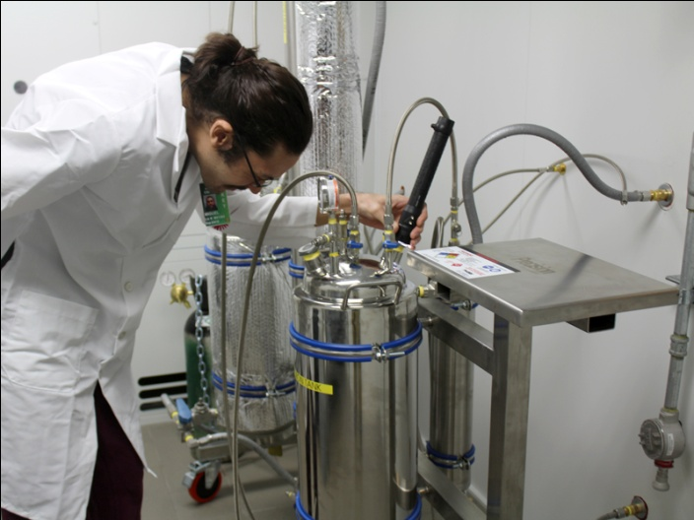
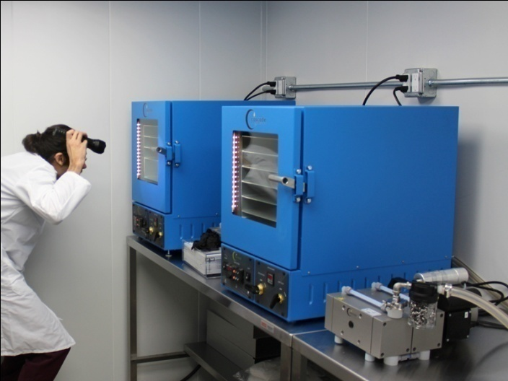
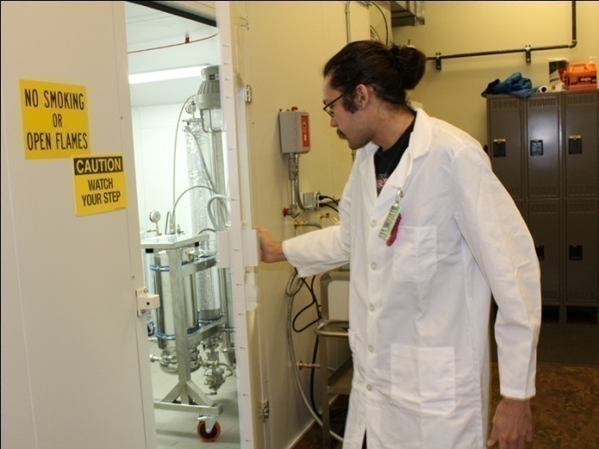
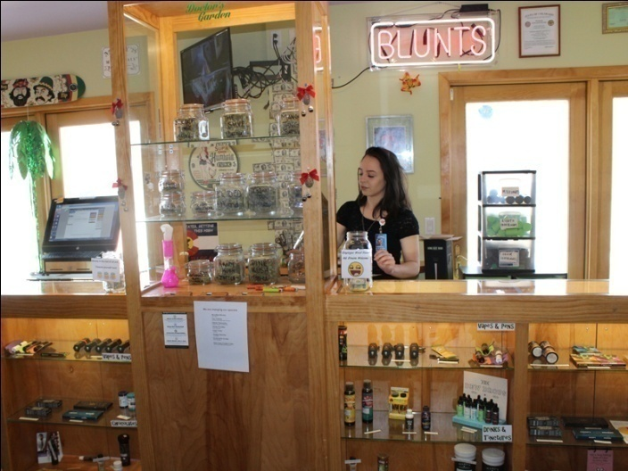
Colorado Product Service pictures

Slide 9
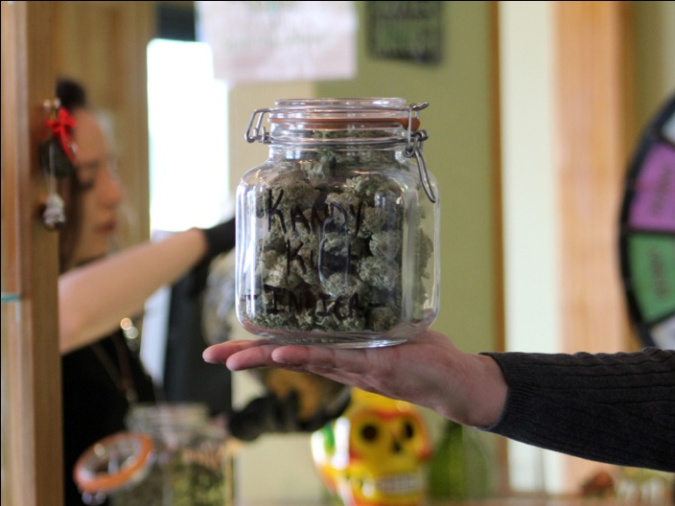
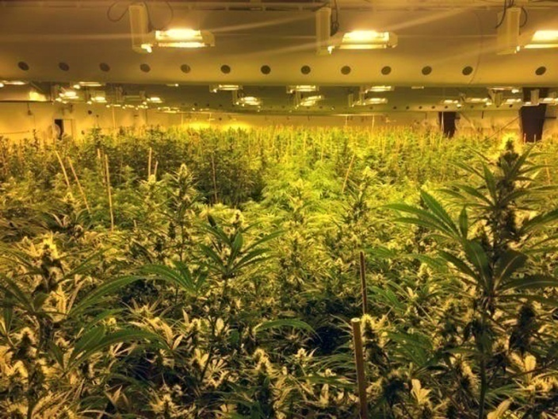
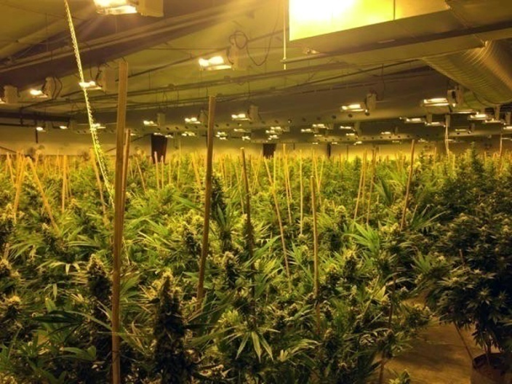
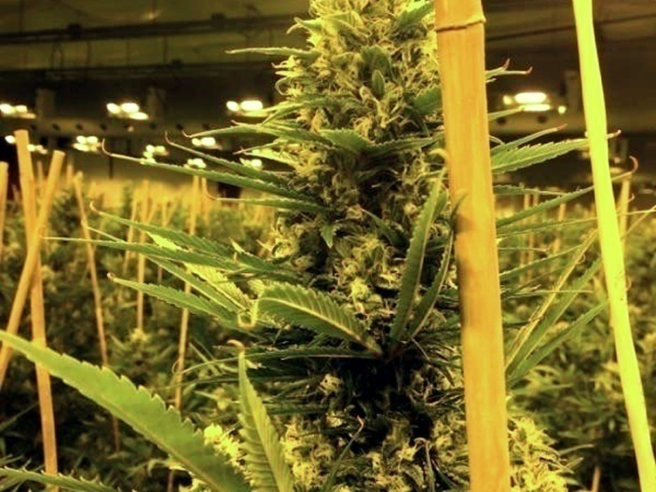
Colorado Product Service pictures

Slide 10
Bio of CPS Managing Partner and CEO
Robert Pinchuck has been President and CEO of Columbia Law List for over 30 years. Columbia Law List has been marketing and consulting law firms since 1905. Columbia Law List owns top ranked attorney products and services, which are listed on columbiafinancial.us. Legal compliance training has been the focus of business operations. Rob Pinchuck entered the cannabis industry 4 years ago and is now Managing Partner and CEO of Colorado Product Services. CPS has one of the largest marijuana licensed facilities in the Rocky Mountains and owns several edible food companies and a vapor pen company called Thai Stick Oil Pens. Robert also owns and manages the first recreational dispensary in the Roaring Fork Valley, named Doctors Garden. Robert Pinchuck works with Fortune 500 companies and employees hundreds of law firms and as well as work with Financial Institutions. Robert Pinchuck has been a legal and cannabis consultant for years and has spoken at conferences throughout the United States and in foreign countries.

Slide 11
Purple Haze Properties
Purple Haze Properties, and its Jimi’s Cannabis Collection has launched exciting lines of quality cannabis products using scientific genetics and creating an education platform to share information from doctors and patients around the world about the advances of cannabis research.Purple Haze Properties will be launching its concept of the Purple Haze Lounges worldwide and will be looking at Denver and Los Angeles for the first ground breaking locations and then Jamaica and Vancouver, B.C, as potential international future locations. These 20,000 sq. ft. "Ultra Lounges" will have a concert hall, restaurants, VIP memberships and charity foundation with themed social areas. We want to give the patron and performer an amazing cultural experience. The property will utilize the best music and video technologies and have some of the finest functional glass art ever seen.Making its debut is the launch of Jimi's Cannabis Collection, a lifestyle brand dedicated to the greatest guitarist in rock and roll history. We decided to launch our brand at the "Marijuana Business Conference and Expo" today in Chicago, "America's oldest and largest national cannabis trade show." Purple Haze Properties is launching Jimi's Cannabis Collection of strains, edibles, and medical CBD topical creams, lotions and throat spray. The medical line will aid in relieving symptoms, such as pain management for throat issues, scars, burns and skin cancer. Jimi's three divisions will cover major areas of the cannabis industry. "Jimi's Genetix" is the division for strains and concentrates. "Jimi's Edibles" is the division of consumable products and "Jimi's Meds" is for non-psychoactive, CBD & Cannabinoid, pharmacy grade, topical throat, and pain management solutions.Jimi Hendrix exclusive licensor is operated by Andrew Pitsicalis with over 20 years in the Cannabis Industry, from Cultivation, to Production, Sales, Education, Media and Consulting. Mr. Pitsicalis, owned one of the largest high end functional glass distribution companies in the world. With the works of the greatest glassblowers, he has distributed these fine works to hundreds of smoke shops and collectors. He was an original partner in Cannabis travel events, High Times events and has had his Glass Collections and Genetics featured in Cannabis Magazines throughout the years. He is a member of Cannabis Science, a leader in cannabis scientific research as the brand and licensing director and sitting member of the policy advisory board. Purple Haze Properties, LLC was founded through a partnership between Andrew Pitsicalis and Leon Hendrix, blood brother to the legendary guitar icon. Purple Haze Properties, LLC is one of the premiere sources for Jimi Hendrix cannabis related products. They participate in all aspects of the cannabis industry including Licensing, Social, Medical, Music and Entertainment areas.
California Green Cultivation.LLC

Slide 12
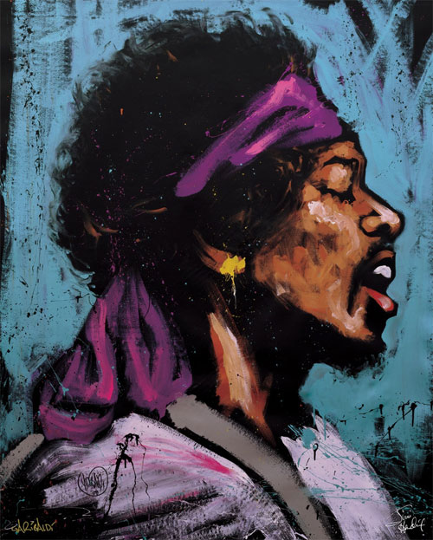
Jimi Hendrix
Hailed by Rolling Stone as the greatest guitarist of all time, Jimi Hendrix was also one of the biggest cultural figures of the Sixties, a psychedelic voodoo child who spewed clouds of distortion and pot smoke.A left-hander who took a right-handed Fender Stratocaster and played it upside down, Hendrix pioneered the use of the instrument as an electronic sound source. Players before Hendrix had experimented with feedback and distortion, but he turned those effects and others into a controlled, fluid vocabulary every bit as personal as the blues with which he began.But while he unleashed noise with uncanny mastery — see: the hard-rock riffs of "Purple Haze," "Foxy Lady," and "Crosstown Traffic" — Hendrix also created tender ballads like "The Wind Cries Mary," the oft-covered "Little Wing," and "Angel," as well as haunting blues recordings such as "Red House" and "Voodoo Chile." Although Hendrix did not consider himself a good singer, his vocals were nearly as evocative as his guitar playing.Hendrix's studio craft and virtuosity with both conventional and unconventional guitar sounds have been widely imitated. His songs have inspired several tribute albums, and have been recorded by a jazz group (1989's Hendrix Project), the Kronos String Quartet, and avant-garde flutist Robert Dick. Beyond his virtuosic guitar playing, gifted songwriting, ahead-of-his-time attention to studio production, and electric stage presence, Hendrix was also an icon that transcended music; nobody else from his era wore an afro better. In the decades since Hendrix's death, pop stars from Rick James and Prince to Lenny Kravitz and Erykah Badu have evoked his look and style. Hendrix's musical vision had a profound effect on everybody from Miles Davis to Sly Stone and George Clinton to Prince and OutKast. Hendrix's theatrical performing style — full of unmistakably sexual undulations and showman tricks like playing the guitar with his teeth and behind his back — has never quite been equaled.

Slide 13
Cannabis Facts and Market Overview
Cannabis is almost federally legal in the United States. As of the date of this report, 39 states have legalized cannabis in some form for recreational or medicinal use.
The current consumer market for recreational and medicinal cannabis in the United States is estimated to be more than $40 billion, including both legal and illegal consumption.
We believe that it is a question of when—not if—the federal prohibition on cannabis will end. In analyzing how the end of prohibition may affect the cannabis industry, we have assumed that prohibition ends by 2020. However, even with federal prohibition, the cannabis industry today is large and dynamic.
We estimate that the U.S. cannabis consumer market for legalized recreational and medicinal use was $4.4 billion in 2015 and will grow to $9.5 billion in 2019. Once legalized federally, we estimate this market will grow to $37 billion within 5 years and $50 billion within 10 years.
Potential cannabinoid-based therapeutic applications have been identified for more than 40 medical conditions, including arthritis, cancer, chronic pain, epilepsy, glaucoma and HIV/AIDS. While this market will not develop until after the end of prohibition, we believe that the future cannabinoid-based pharmaceuticals market may ultimately exceed $50 billion annually.
Therefore, we believe that there is a potential $100 billion market for cannabis. A broad range of investment opportunities exists both now and in the future for sophisticated investors who are willing to take significant risks.

Slide 14

Business Model
01
Purple Haze Properties (Jimi Hendrix Licensor)
02
California Exclusive Licensee of Jimi Hendrix
Works (T-shirts, Key chains, Memorabilia)
In branding cannabis edibles and medicine
CGC / California Green Cultivation, LLC
03
Sub licensees
Licensee fees: $25,000 to $50,000 upfront + 20% Royalty
(15% to Purple Haze Properties and 5% to CGC)
Edibles and medicine Production Companies and Manufacturers
04
6,459 Dispensaries in California
(Wholesale Buyers)
05
Estimated 1,250,000 Medical license holding consumers in California
Notes:
CGCCGC

Slide 15
Investment Income Projection
Investment amount: $2,000,000
4 year Investor Income: $10,084,698
Total ROI in 4 years: 400%
100% ROI per year
Notes:
CGCCGC

Slide 16
3 YER SALES AND INCOME Projection
JH SUB LICENSE SALES PROJECTION
Royalty Projection | 1st Year | 2nd Year | 3rd Year
6,459 distribution units in CA | 6,459 | 6,459 | 6,459
Projected % Market Share | 30% | 40% | 50%
Projected 1 Unit Sales per Day | 1,938 | 2,584 | 3,230
# Days per Month | 30 | 30 | 30
# Unit Sales per Month | 58,131 | 77,508 | 96,885
# Months per Year | 12 | 12 | 12
# Unit Sales per Year | 697,572 | 930,096 | 1,162,620
# Products sells by Category | 5 | 10 | 20
Total # Units Sales per Year | 3,487,860 | 9,300,960 | 23,252,400
Wholesale Sales Profit per Unit | $10.00 | $10.00 | $10.00
Total $ Units Sales per Year | $34,878,600.00 | $93,009,600.00 | $232,524,000.00
Sub License Royalty | 5% | 5% | 5%
Total $ Royalty per Year | $1,743,930.00 | $4,650,480.00 | $11,626,200.00
# Products in Category increases by 100% each year
Sub License Guarantees | 1st Year | 2nd Year | 3rd Year
Sub License Guarantee per Licensee | $30,000.00 | $30,000.00 | $30,000.00
# of Signing Sub Licensees | 30 | 50 | 70
Total Sub License Guarantee | $900,000.00 | $1,500,000.00 | $2,100,000.00
Notes:
CGCCGC

Slide 17
3 year Sales AND INCOME Projection
JH SUB LICENSE SALES PROJECTION
6,459 distribution units in CA
Memorabilia Sales Projection | 1st Year | 2nd Year | 3rd Year
# of Dispenary | 6,459 | 6,459 | 6,459
Projected % Market Share | 30% | 40% | 50%
Projected 1 Unit Sales per Dispensary | 1,938 | 2,584 | 3,230
CGC Profits per Month per Dispensary | $300.00 | $300.00 | $300.00
Total Profits per Month | $581,310.00 | $775,080.00 | $968,850.00
# Months per Year | 12 | 12 | 12
Total Profits per Year | $6,975,720.00 | $9,300,960.00 | $11,626,200.00
JH SUB LICENSE INVESTING ROI
 | 1st Year | 2nd Year | 3rd Year
Royalties | $1,743,930.00 | $4,650,480.00 | $11,626,200.00
Sub License Guarantees | $900,000.00 | $1,500,000.00 | $2,100,000.00
Memorabilia Profits | $6,975,720.00 | $9,300,960.00 | $11,626,200.00
Total Sales Revenues | $9,619,650.00 | $15,451,440.00 | $25,352,400.00
Projected Investor % Share | 20% | 20% | 20%
Total Investor $ Share per Year | $1,923,930.00 | $3,090,288.00 | $5,070,480.00
Investor's Funding Amt | $ 2,000,000.00 | - | -
Investor's Aggregated ROI | -4% | 151% | 404%
Notes:
CGCCGC

Slide 18
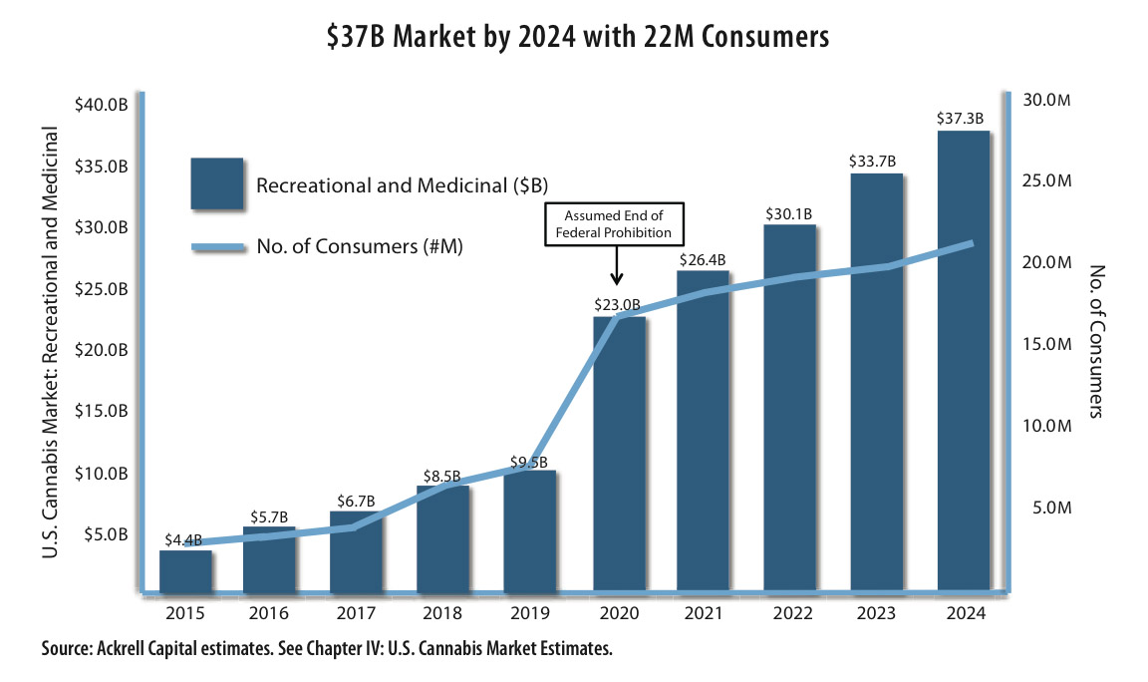
U.S. Cannabis Consumer Market: Recreational and Medicinal
Report
Highlights

Slide 19
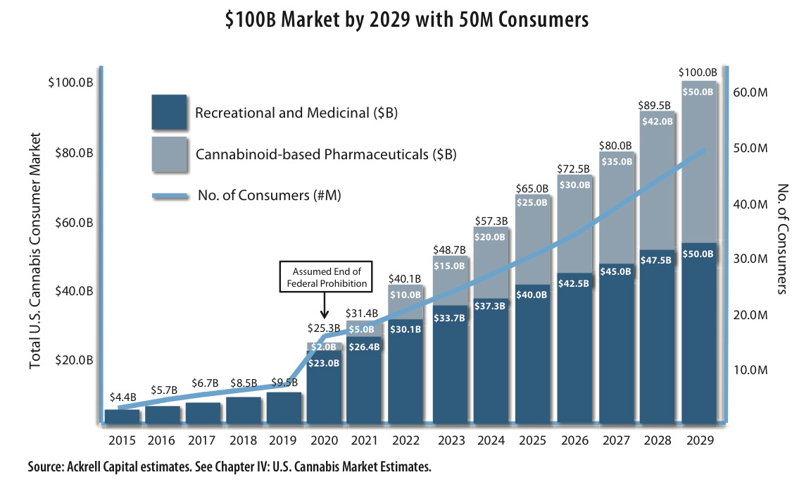
Report
Highlights
Total U.S. Cannabis Consumer Market: Including Pharmaceuticals

Slide 20
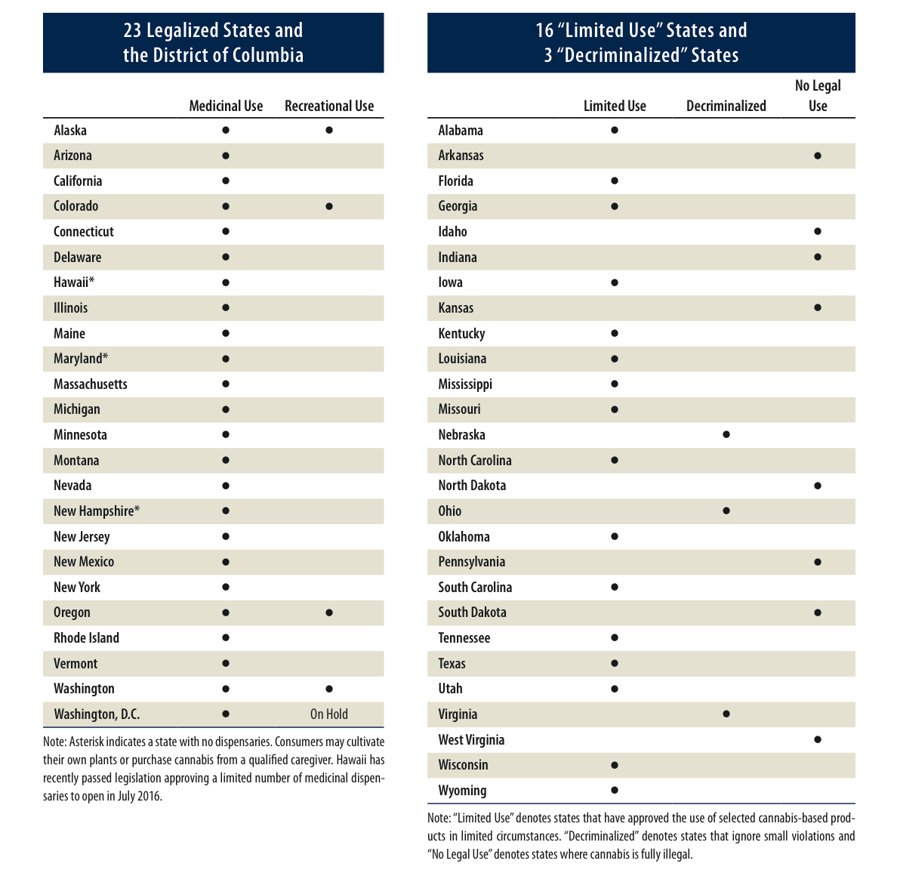

Slide 21
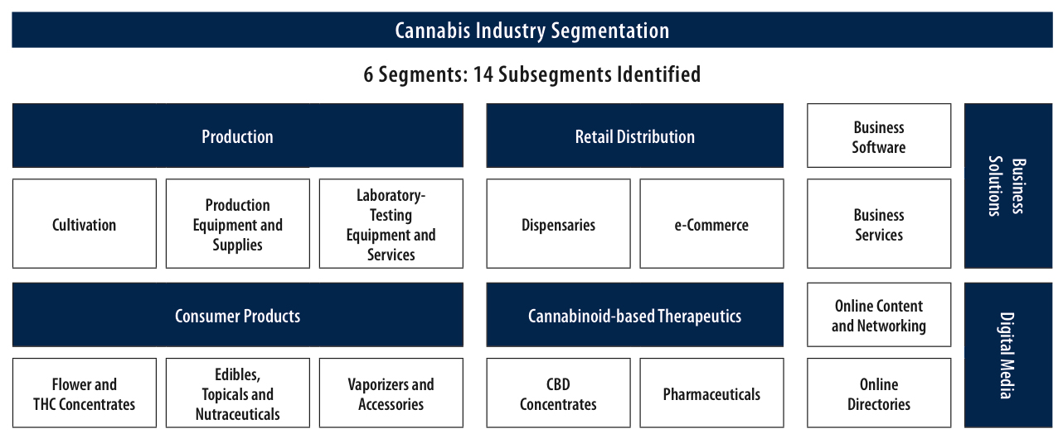

Slide 22
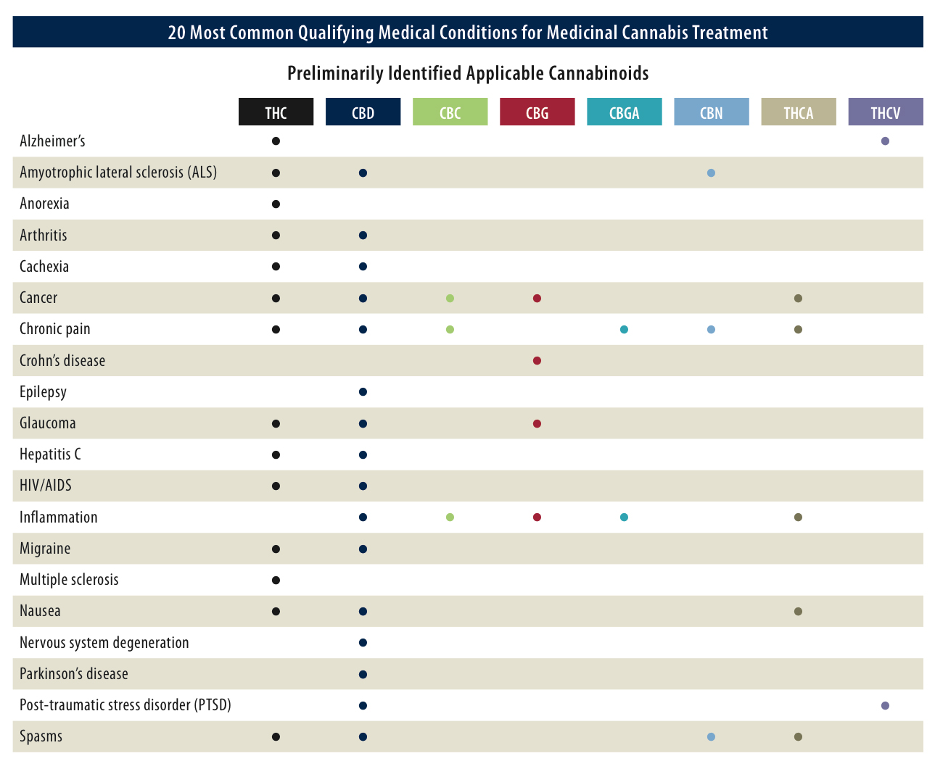

Slide 23
Jimi Hendrix & Cannabis
Jimi’s macaroons is the High Times Edibles of the month
Also won 4th place at Cannabis Cup
Jimi Hendrix has over 2 billion fans worldwide
Forbes rated Jimi Hendrix as one of the top 10 cannabis brands
California’s Finest recently launched a Jimi Hendrix pre-roll pack that has sold over 1,000 units during a single event- Cannabis Cup in California
Purple Haze Properties is building a Los Angeles Jimi Hendrix lounge that will focus on cannabis products, entertainment, and dining– Established record of success

Slide 24
What’s in it for CGC?
Have the rights to sub license and produce edibles and/or medical products (ingestible or topical), with Jimi Hendrix name/face
Have the rights to sell all Jimi Hendrix merchandise/memorabilia (t-shirts, key chains, etc.) to dispensaries. Every dispensary wants Jimi’s face in their stores.
Ability to sell marijuana in pre-roll packs and extracts
Penetration into large chain dispensaries that would only be achievable with Jimi branded products
International recognition with Purple Haze Properties fan base and followers
Ties existing CPS’s CBD products to Jimi Hendrix product line and will be available to vast California consumer
Jimi Hendrix has a point system- based on purchases, Jimi will send customers memorabilia and other gifts. Each store is included in system to track points for Jimi purchases.
Quality and Price will make them return customers– Will have accumulation on of information on every customer that buys Jimi products in California

Slide 25
Using Jimi Hendrix Intellectual Property
For marketing purposes, CCC will have access to a server with all Jimi graphics, song titles, interviews, decks, etc. Using this server will make for branding and marketing seamless for cannabis products and memorabilia
Can name product lines after song titles
The Jimi Hendrix brand is already established with an estimated 2 billion fans worldwide that follow Jimi Hendrix media and history
Jimi Hendrix products will automatically reach market with a brand awareness and a consumer curiosity that should entice them to try the product

Slide 26
Purple Haze Properties PR Value
94,174 followers on Facebook since May 2015
Direct connections to Rolling Stone Mag and other nationally recognized publication
PHP has 20+ year relationship with High Times magazine
Large Los Angeles cannabis publication will write about us and PHP that will draw attention to the CCC name
PHP CEO, Andrew Pitsicalis, has connections to many big industry leaders and celebrities
PHP is building a cannabis club and concert venue in Los Angeles that will buy millions of dollars a year in memorabilia and cannabis products from CPS
Huge media blitz for CCC with PHP PR company in Hollywood

Slide 27
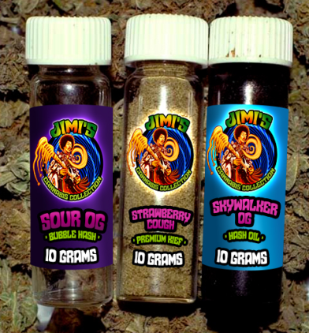
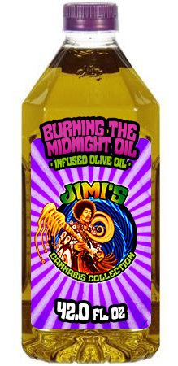
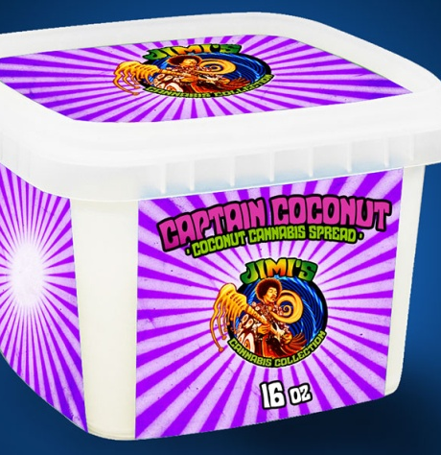

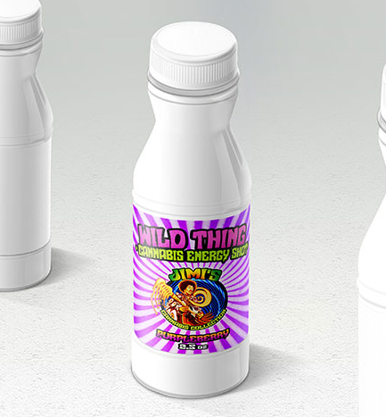
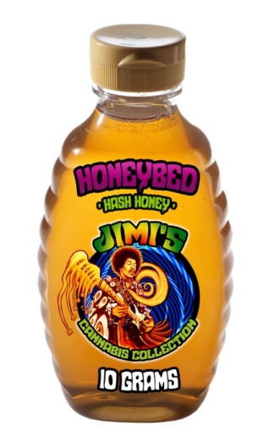
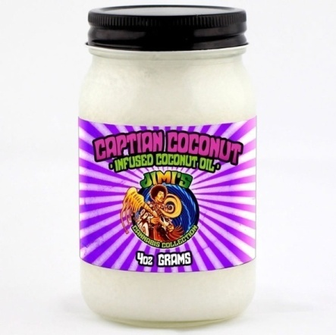
Purple Haze Products
01
02
03
Vials of Oil and Hash
Burning the Midnight Oil Olive Oil
Captain Coconut Cannabis Spread
04
05
06
Wild Thing Energy Shot
Honeybed Hash Honey
Captian Coconut Oil
Jimi's Edibles

Slide 28
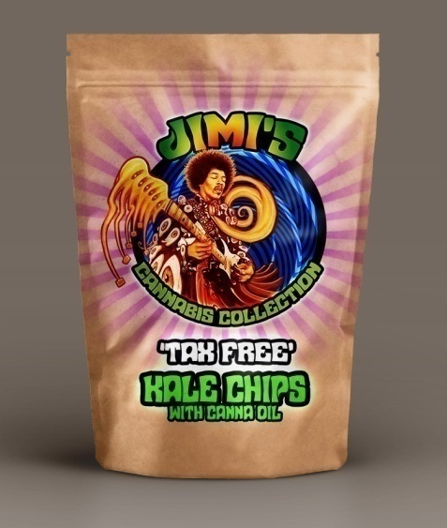
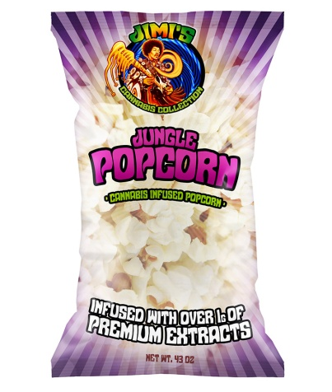
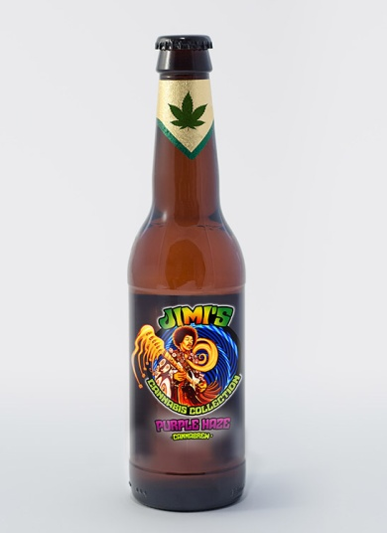
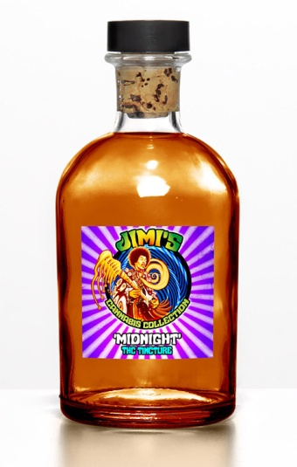
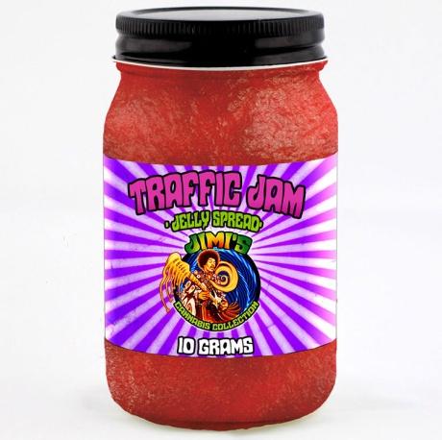
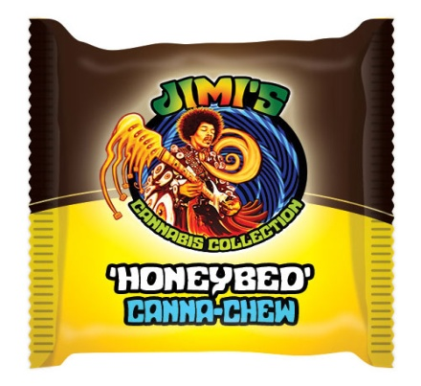
Purple Haze Products
07
08
09
Tax Free Kale Chips
Jungle Popcorn
Purple Haze
10
11
12
Midnight Tincture
Astro Man Jelly Spread
Honeybed Canna Chew
Jimi's Edibles

Slide 29
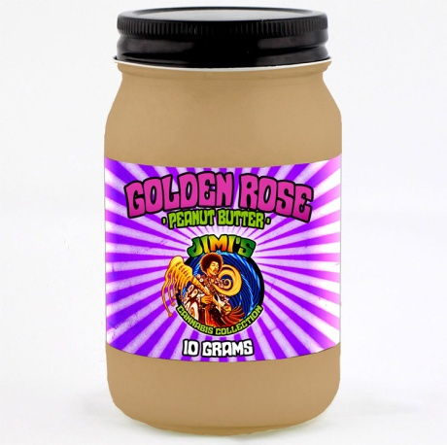
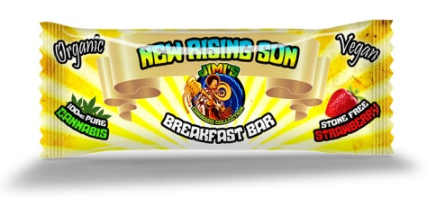
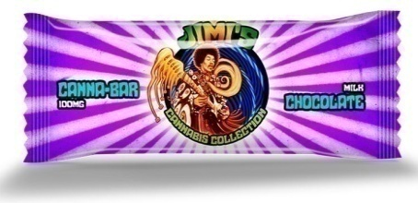
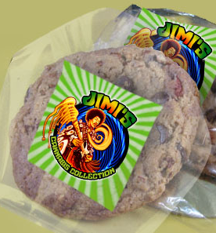
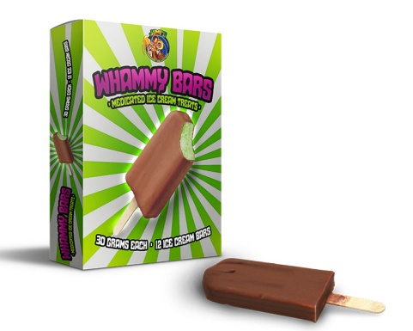
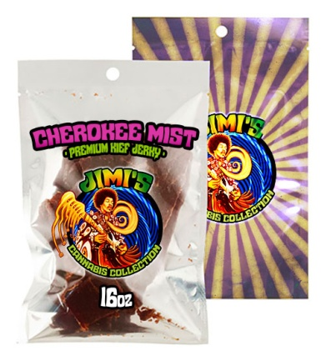
Purple Haze Products
13
14
15
Golden Rose Peanut Butter
New Rising Sun Breakfast Bar
Canna-Bar Chocolate
16
17
18
Whammy Bars
Cherokee Mist beef-jerky
Cannabis Cookies
Jimi's Edibles

Slide 30
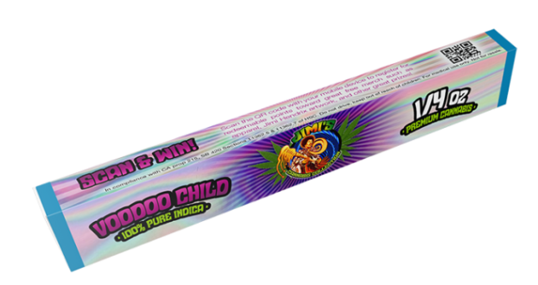
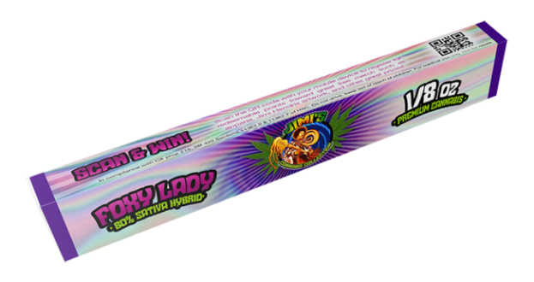
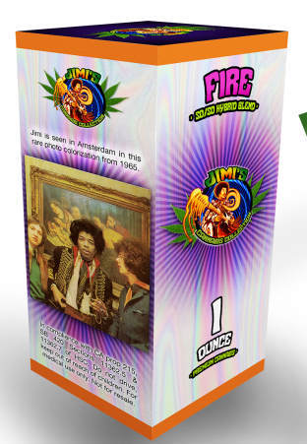
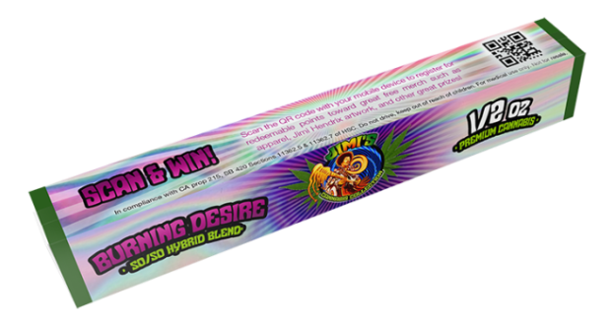
Purple Haze Products
01
02
Voodoo Child
Foxy Lady Sativa Hybrid
03
04
Burning Desire Hybrid Blend
Fire Hybrid Blend
Jimi's Genetix

Slide 31
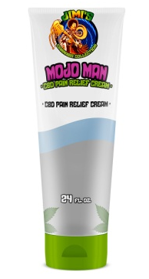
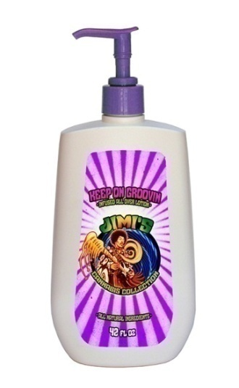
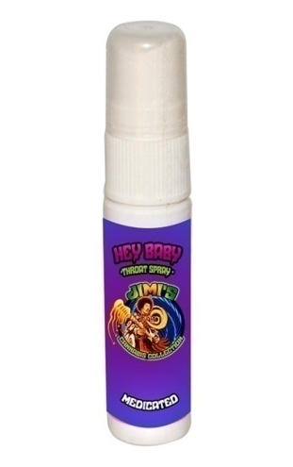
Purple Haze Products
01
02
03
Mojo Man Pain Relief Cream
Keep On Groovin Lotion
Red House Throat Spray
Jimi's Meds

